Slide 1
Team Members: 1.Hayam Mostafa Abdelhamid 2201828 2.Noor Hussam Mohammed 2200042 3.Ayat Ahmed Bahnsawy 2201006 4.Habiba Ayman Abdelrhman 2201140 5.Nada Ahmed Amin 2201788 6.Shrouk Rafeq Nabeh 2201200 7.Alaa Emad Moustafa 2201673

Slide 2

Introduction
Ping Pong with AI is a simple two-player game where one player controls the left paddle using the keyboard, while the right paddle is controlled by an AI. The objective is to hit the ball past the opponent’s paddle to score points. The AI tracks the ball's vertical movement and moves the right paddle accordingly. The game features basic ball physics with bounces from the top and bottom walls, and when the ball passes a paddle, the other player scores a point. The score is displayed at the top, and the game continues until a set number of points is reached.

Slide 3

The Minimax algorithm is a decision-making algorithm commonly used in two-player games, especially in turn-based games like Ping Pong, Chess, or Tic-Tac-Toe. Its goal is to minimize the possible loss for a player assuming the opponent is also playing optimally. Minimax in Ping Pong (Simplified): Maximizing player: The AI paddle tries to maximize its chances of intercepting the ball or minimizing the chance of the ball passing it. Minimizing player: The opponent (the ball) tries to move in such a way as to avoid getting hit by the AI paddle.
Minimax Algorithm

Slide 4
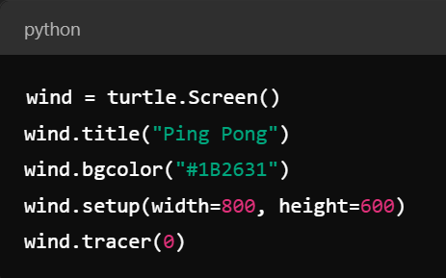
Explanation Code:
1.Setting Up Window:
turtle.Screen(): Initializes the main game window.
wind.title("Ping Pong"): Sets the title of the window to "Ping Pong".
wind.bgcolor("#1B2631"): Sets the background color of the window to a dark shade.
wind.setup(width=800, height=600): Defines the window size as 800x600 pixels.
wind.tracer(0): Disables automatic screen updates for smoother animations (only updates when wind.update() is called).

Slide 5
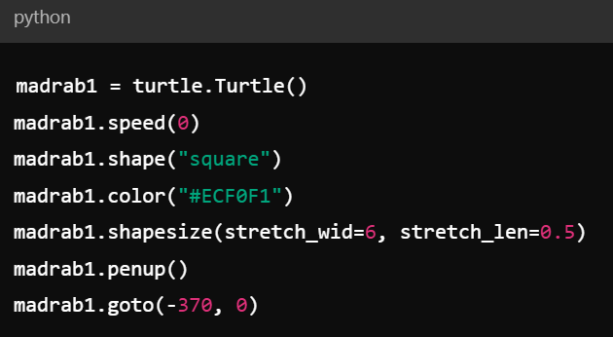
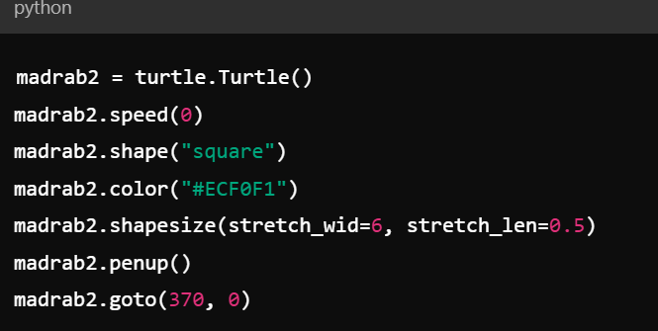
2. Creating Paddles:
Left Paddle (Player 1)
madrab1: Creates the left paddle (Player 1).
speed(0): Makes the paddle move instantly.
shape("square"): Sets the paddle shape to a square.
color("#ECF0F1"): Sets the paddle color to a light gray shade.
shapesize(stretch_wid=6, stretch_len=0.5): Stretches the square shape to form a tall, narrow paddle.
penup(): Lifts the pen to prevent drawing on the screen.
goto(-370, 0): Positions the left paddle at the coordinates (-370,0)
Right Paddle (Player 2 - AI Controlled)
madrab2: Creates the right paddle (Player 2), which is AI-controlled.
Similar to madrab1, but this paddle is positioned at (370, 0).

Slide 6
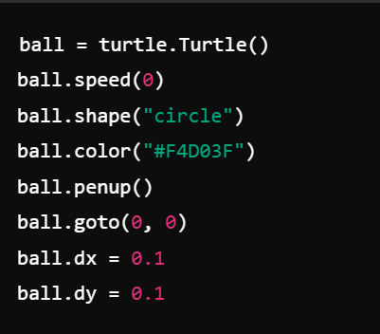
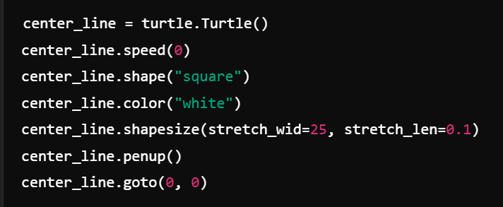
3. Creating the Ball:
ball: Creates the ball.
speed(0): Makes the ball move instantly.
shape("circle"): Sets the ball shape to a circle.
color("#F4D03F"): Sets the ball color to a bright yellow shade.
penup(): Lifts the pen to prevent drawing on the screen.
goto(0, 0): Positions the ball at the center of the screen.
dx = 0.1 and dy = 0.1 set the ball's initial velocity in
the x and y directions to 0.1 units per time step.
4. Creating the Center Line:
center_line: Creates a vertical line in the center of the screen
to visually separate the two sides of the game.
shapesize(stretch_wid=25, stretch_len=0.1): Stretches the square shape
to form a long vertical line.

Slide 7
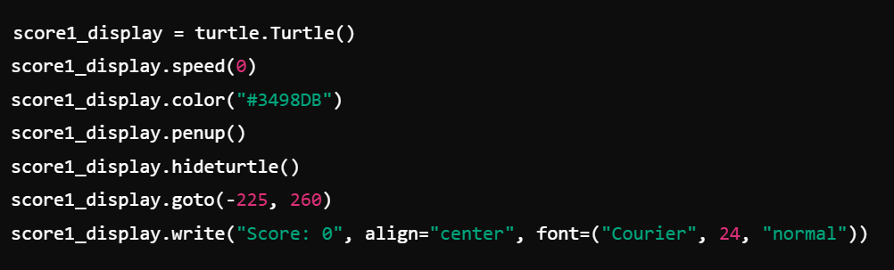
5. Creating Score Displays:
Player 1 Score
score1_display: Creates a turtle to display Player 1's score.
color("#3498DB"): Sets the score color to blue.
penup(): Lifts the pen to avoid drawing lines.
hideturtle(): Hides the turtle after it writes the score.
goto(-225, 260): Positions the score at the top-left of the screen.
write("Score: 0", ...): Displays the initial score for Player 1.
Player 2 Score
Similar to score1_display, but for Player 2,
using a red color and displaying Player 2's score.

Slide 8
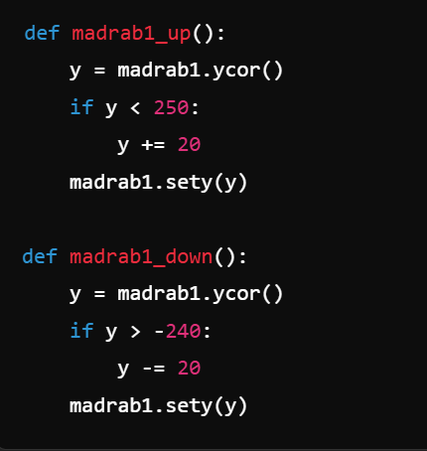
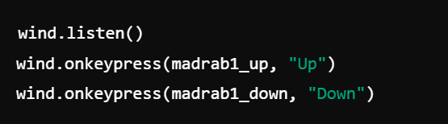
6. Functions for Moving Paddles:
Left Paddle Movement (Player 1)
madrab1_up(): Moves the left paddle (Player 1) up by 20 pixels,
ensuring it doesn't go off-screen.
madrab1_down(): Moves the left paddle down by 20 pixels,
also ensuring it stays within screen boundaries.
7. Keyboard Bindings for Player 1 :
wind.listen(): Starts listening for keypress events.
wind.onkeypress(madrab1_up, "Up"): Binds the "Up" arrow key
to move the left paddle up.
wind.onkeypress(madrab1_down, "Down"): Binds the "Down“
arrow key to move the left paddle down.

Slide 9
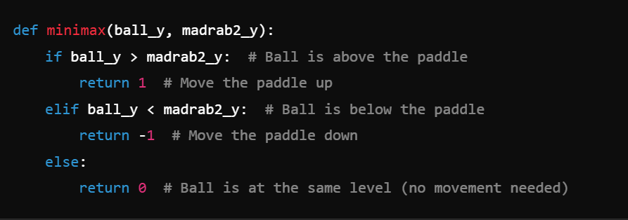
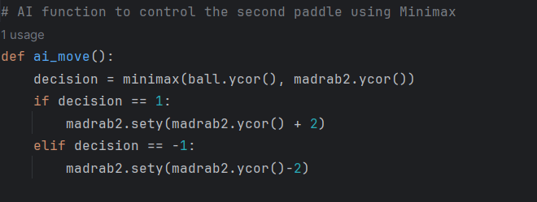
8.Minimax Function:
The minimax function is a simple decision-making process that evaluates the position of the ball relative to the AI paddle (madrab2).
The parameters ball_y and madrab2_y represent the y-coordinates of the ball and the paddle, respectively.
9. AI for Right Paddle (Player 2) :
If ball.ycor() > madrab2.ycor():
This checks if the ball is below the AI paddle. If true,
the AI paddle moves down by 2 units to follow the ball.
Elif ball.ycor() < madrab2.ycor():
This checks if the ball is above the AI paddle. If true, the AI paddle moves up by 2 units to track the ball.

Slide 10
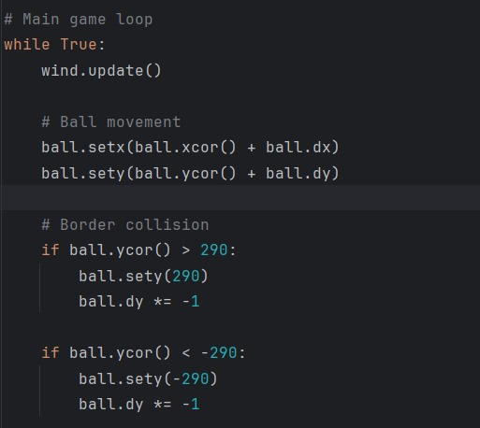
10. Main Game Loop:
while True: starts an infinite loop, keeping the game running until a stop condition is met which is game over.
wind.update(): refreshes the screen after each frame, preventing unnecessary flickering by updating the display only when needed.
ball.setx(ball.xcor() + ball.dx) updates the ball's horizontal position by adding its horizontal speed (dx) to the current x-coordinate.
ball.sety(ball.ycor() + ball.dy) updates the ball's vertical position by adding its vertical speed (dy) to the current y-coordinate.
Border Collision Handling:
if ball.ycor() > 290: checks if the ball hits the top border.
ball.sety(290) repositions the ball to the top.
ball.dy *= -1 reverses the ball's vertical direction.
if ball.ycor() < -290: checks if the ball hits the bottom border.
ball.sety(-290) repositions the ball to the bottom.
ball.dy *= -1 reverses the ball's vertical direction.

Slide 11
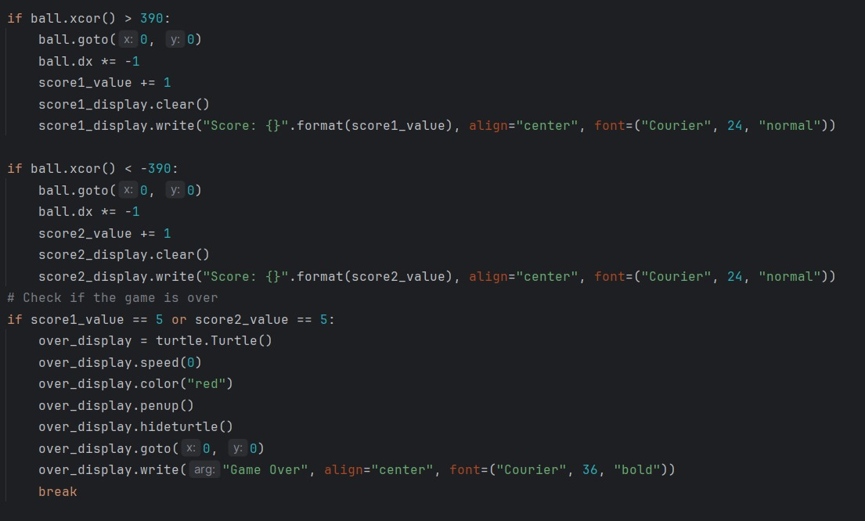
1.Right Border Collision and Scoring:
if ball.xcor() > 390: checks if the ball crosses the right boundary.
ball.goto(0, 0) resets the ball to the center.
ball.dx *= -1 reverses the ball's horizontal direction.
score1_value += 1 awards a point to Player 1.
score1_display.clear() clears the previous score.
score1_display.write(...) updates and displays Player 1's score.
2. Left Border Collision and Scoring:
if ball.xcor() < -390: checks if the ball crosses the left boundary.
ball.goto(0, 0) resets the ball to the center.
ball.dx *= -1 reverses the ball's direction.
score2_value += 1 awards a point to Player 2.
score2_display.clear() clears the old score.
score2_display.write(...) updates and displays Player 2's score.
3. Game Over Condition:
if score1_value == 5 or score2_value == 5: checks if a player reaches 5 points.
over_display = turtle.Turtle() creates a turtle to display
the "Game Over" message.
over_display.write("Game Over", ...) shows the "Game Over“
message at the center.
break stops the game loop, ending the game.

Slide 12
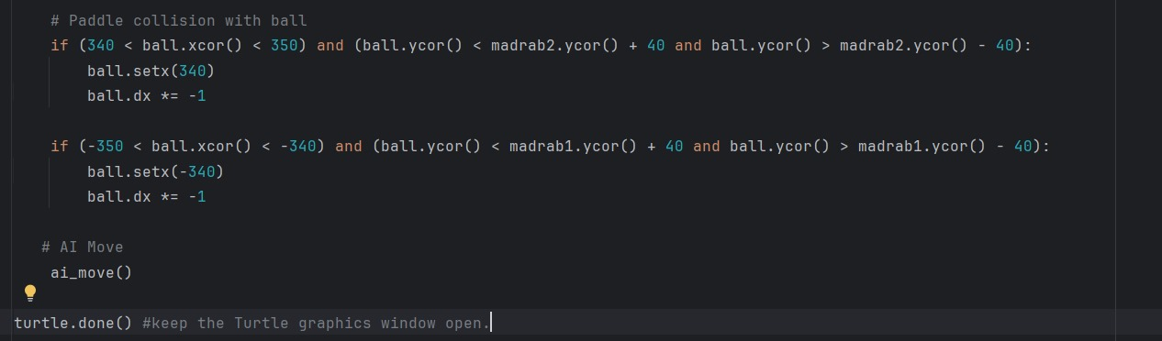
Paddle Collision with Ball:
The first condition checks if the ball is near Player 2's paddle (right side). If the ball is within the paddle's range, it moves the ball slightly to the paddle’s edge and reverses its direction (so it bounces off).
The second condition checks if the ball is near Player 1's paddle (left side). If the ball is within the paddle's range, it moves the ball to the edge of the paddle and bounces it back.
11. Keep the Window Open:
turtle.done(): Keeps the game window
open after the main loop finishes.

Slide 13
Thank you

